Slide 1
Digital Portfolio
STUDENT NAME: M.SHABANA BANU
REGISTER NO AND NMID: 02EAE2D45C0B3EA82E74B1487760F413
DEPARTMENT: B.Sc Computer science
COLLEGE: COLLEGE/ UNIVERSITY:Jaya women's arts and science college (Madras University)

Slide 2
PROJECT TITLE
My Education Portfolio

Slide 3


AGENDA
Problem Statement
Project Overview
End Users
Tools and Technologies
Portfolio design and Layout
Features and Functionality
Results and Screenshots
Conclusion
Github Link
3/21/2024 Annual Review

Slide 4

PROBLEM STATEMENT
Students often need a way to present their academic journey , skills, achievements , and projects in a structured and attractive manner.
A simple document or resume is not interactive and does not highlights their projects
Effectively.
The goal of this project is to design and develop a digital education portfolio
using HTML,CSS, and JavaScript .The portfolio should :
Present basic academic information such as school, UG course , and subjects.
Showcase skills, achievements, and extra curricular activities in a professional Layout.

Slide 5

PROJECT OVERVIEW
SUMMARY OF THIS PROJECT
This project is a digital portfolio designed for undergraduate students to present their academic journey, skills, achievements, and projects in an interactive way .It is build using HTML for structure , CSS for design and styling ,and JavaScript for interactivity .
WHAT THE PORTFOLIO CONTAINS
About me / Academic Background – information about school and current U,G course.
Projects – Mini projects with interactive details.
Skill & Subjects – Core technical and soft skills learned .
Achievements – Awards , recognitions , and competition.

Slide 6
Extracurricular Activities –non academic constribution.
Contact section –email ,linkedln, and phone number

Slide 7
MAIN IDEA The main idea of this project is to showcase personal achievements , academic details , skills , and projects in a modern , visually appealing , and interactive portfolio format that can be used by students for academic and professional purposes.

Slide 8

WHO ARE THE END USERS?
Students (UG, PG) –to showcase their academic , skills , achievements , and projects.
Teachers & Faculty Members-to evaluate student progress , projects , and extracurricular contribution.
Recruiters / Employers –to review candidates profiles , technical skills , and mini-projects during internship or placements.
Peers & Collaborators –to connect with classmates or team members for academic or project work .
General Audience (Friends and family) –to view personal growth , achievements , and milestones .

Slide 9

TOOLS AND TECHNIQUES
HTML –Skills , to built the structure of the portfolio (About , Projects , Contact)
CSS –to design and style the layout with colours, cards , and responsive design .
JavaScript –to add interactivity (expand / collapse project details , alert messages).
Card Layout –to organize section clearly .
Responsive Design –to ensure the portfolio works on desktop and mobile screens .

Slide 10
PORTFOLIO DESIGN AND LAYOUT
DESIGN APPROACH
Simple & clean UI –Focus on readability and user -friendly navigation.
Card- based layout –each section (About , Skills , Project , Achievements , and contact) .
is displayed inside visually separated “cards”.
Colour scheme –soft background with highlighted headers to give a modern look .
Responsive layout –works well on desktop , tablet , and Mobile Devices .
Consistent styling –same font , colours , and rounded card edges for uniformity.
10

Slide 11
LAYOUT STRUCTURE
1. HEADER SECTION –title and tag line ( eg., “My Education Portfolio”) .
2. ABOUT / ACADEMIC BACKGROUND –Personal intro and education details .
3. SKILLS & SUBJECTS –Technical and non-technical skills .
4. ACHIEVEMENTS –Awards , contest and recognitions .
5. PROJECT SECTION –Expandable project details (interative) .
6. EXTRACURRICULAR ACTIVITIES –Non-academic activities .
7. CONTACT SECTION –Email , linkedln , and phone number + interactive button .
8. FOOTER –Author name and copyright note

Slide 12
FEATURES AND FUNCTIONALITY
FEATURES
Clean and user friendly design .
Card-based section layout.
responsive (works on all devices) .
Interactive projects ( expand /collapse) .
Contact info with clickable button .
FUNCTIONALITY
HTML –Structure of portfolio .
CSS –styling , layout , colours .
JavaScript –interactivity (alerts , toggle projects ) .

Slide 13

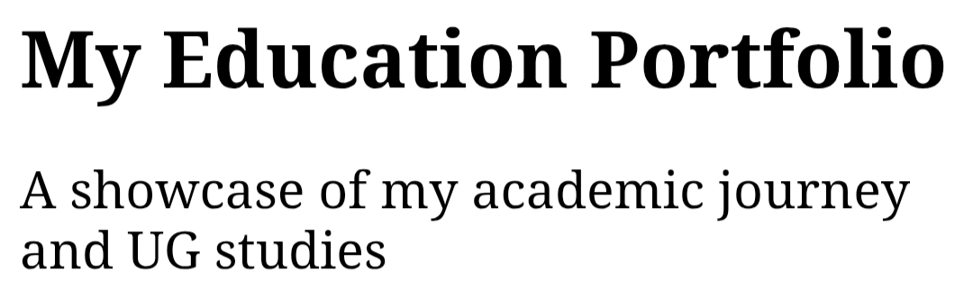

RESULTS AND SCREENSHOTS
3/21/2024 Annual Review
13

Slide 14
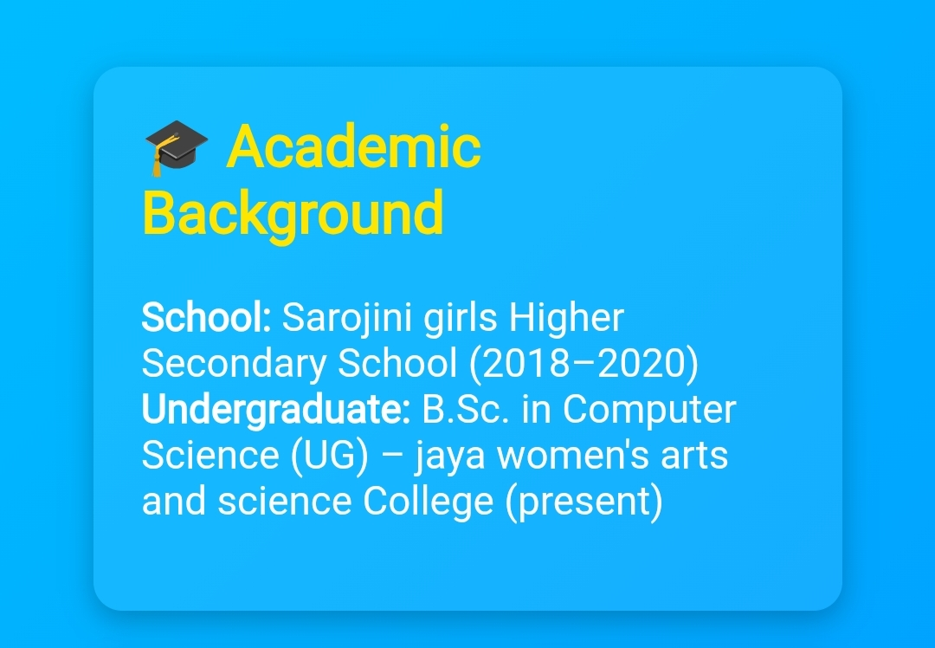
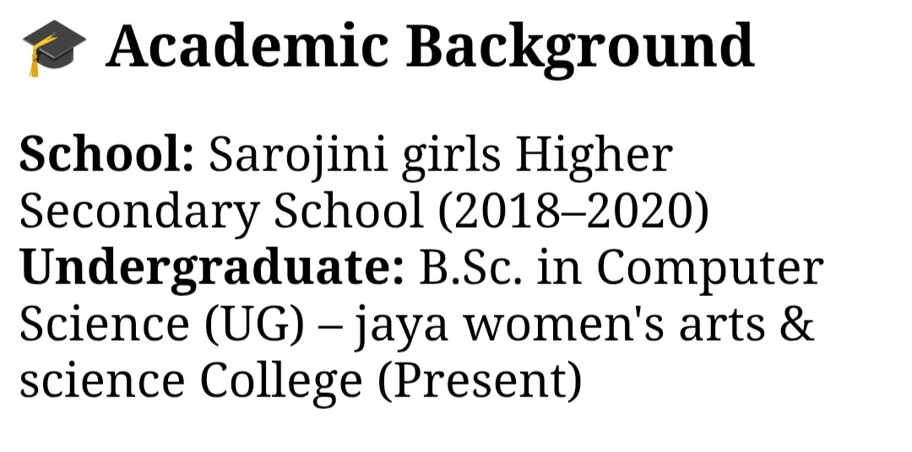

Slide 15
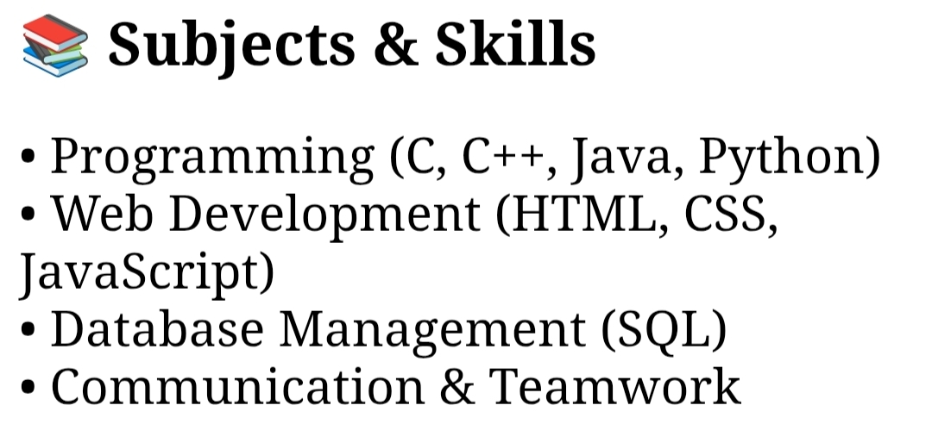
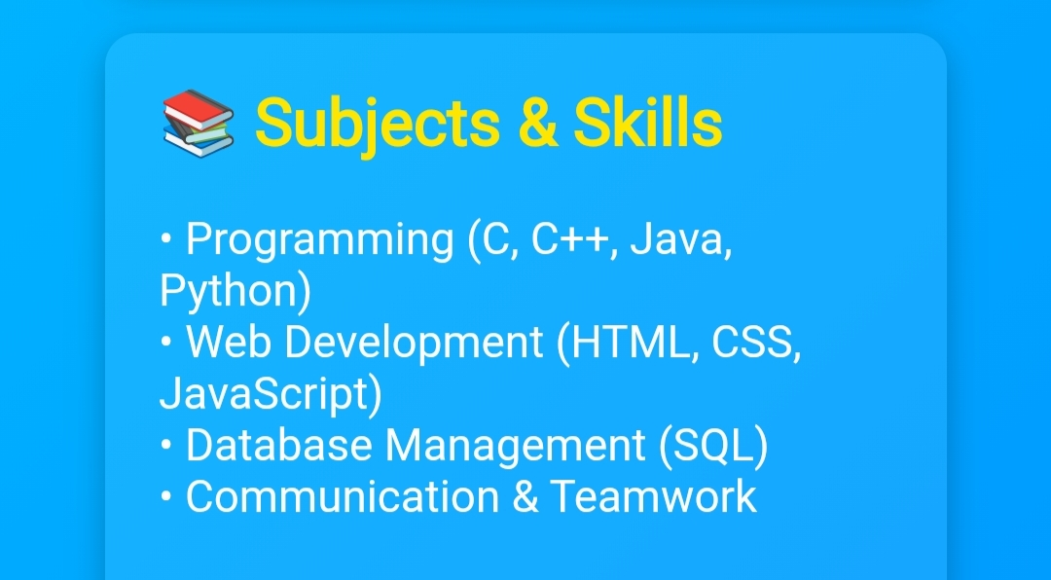

Slide 16
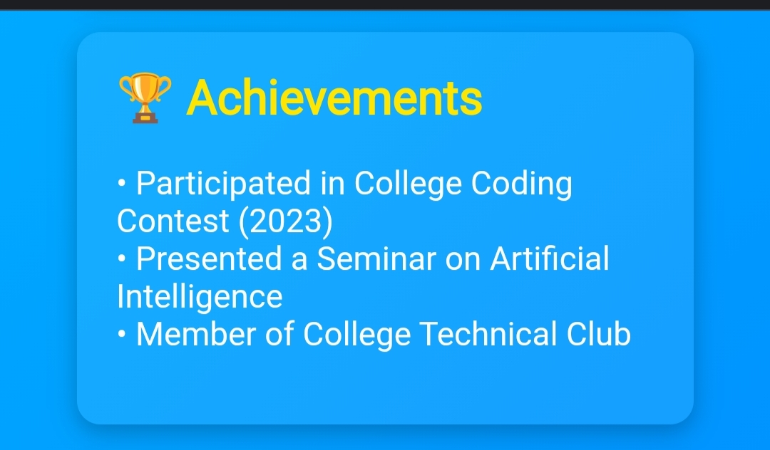
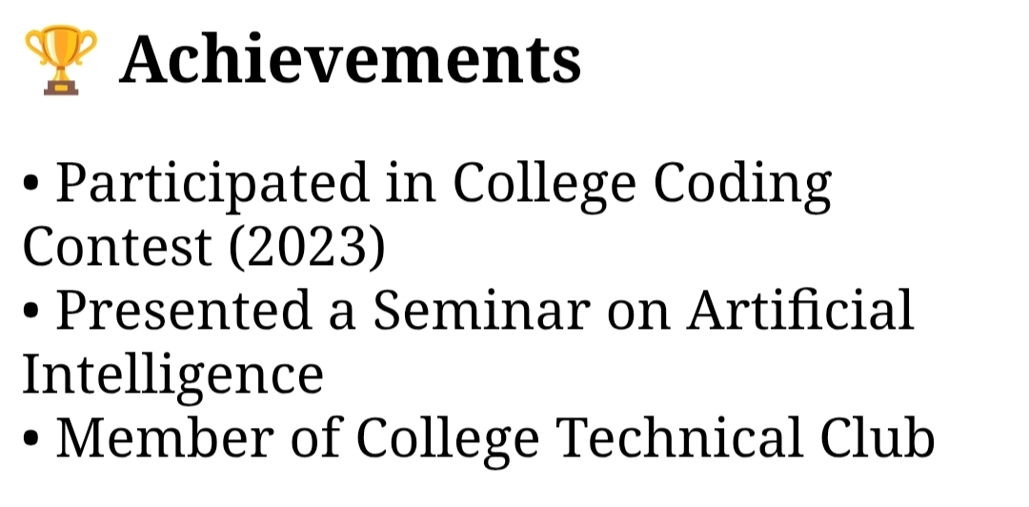

Slide 17
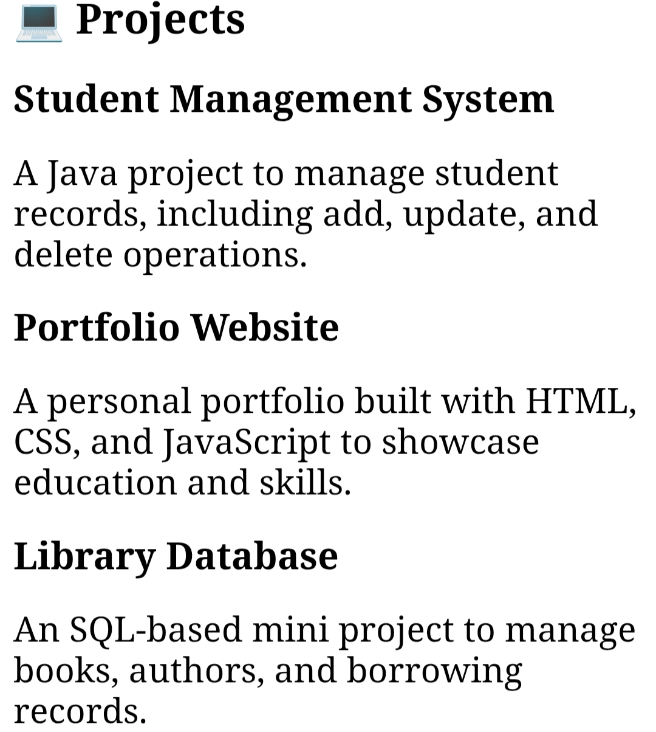
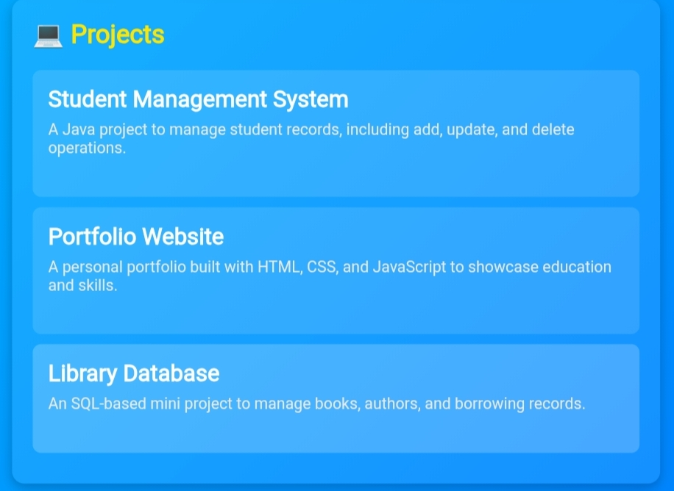

Slide 18
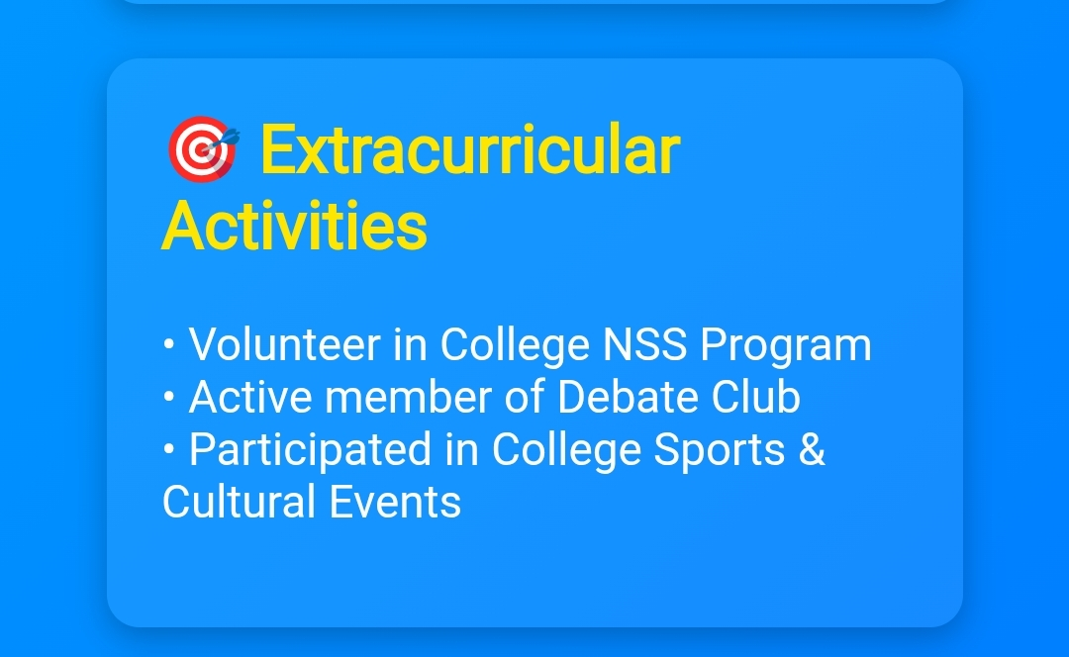


Slide 19
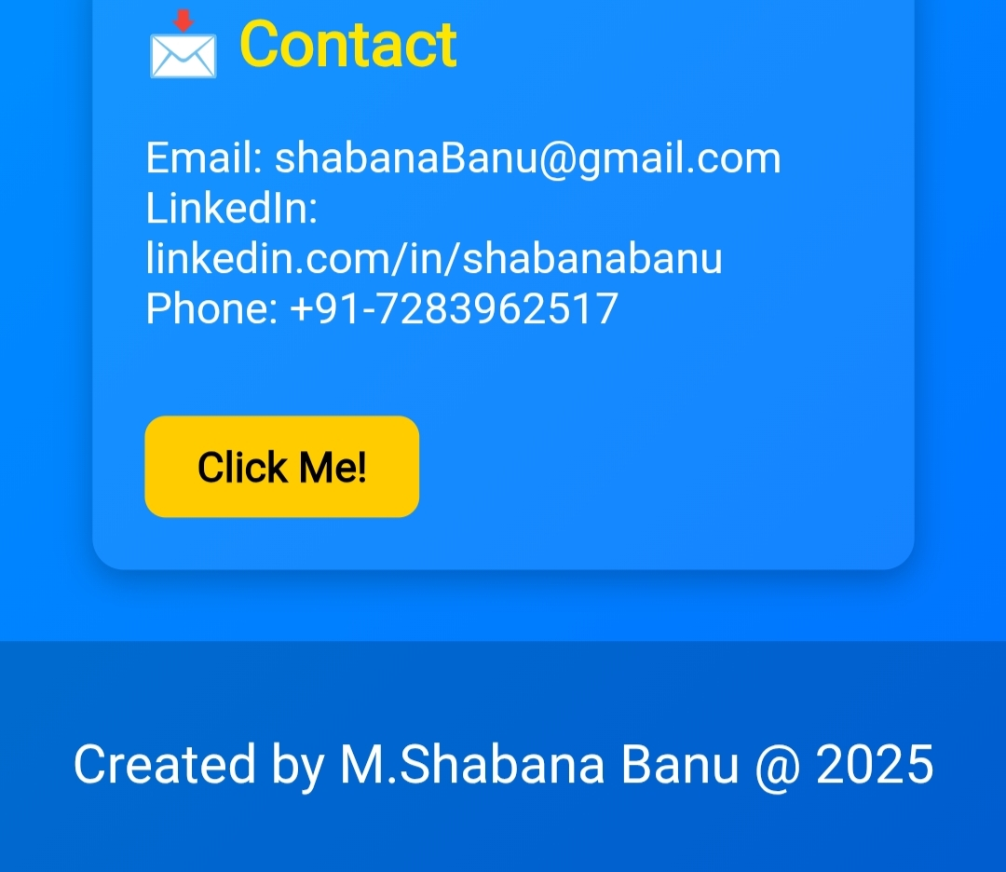
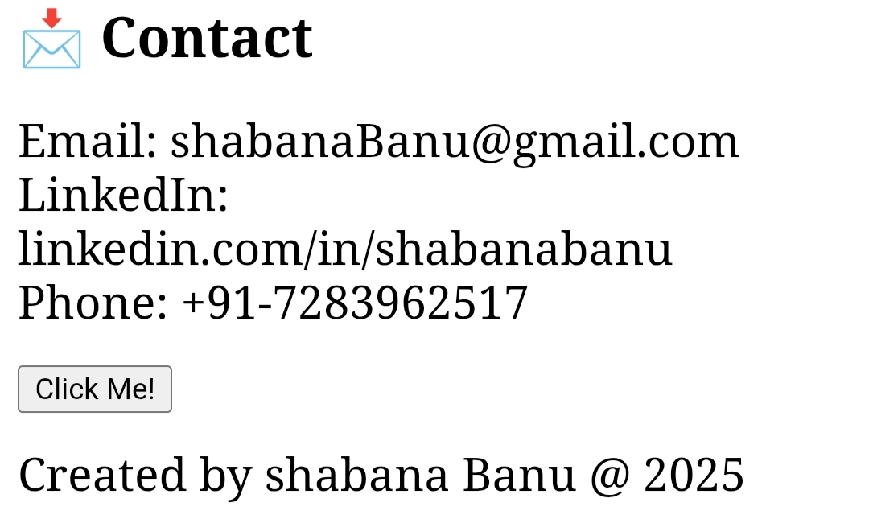

Slide 20
CONCLUSION
HIGHLIGHTS
Personal profile.
Academic Achievements.
Skills & Competencies
Projects and work samples.
Extracurricular activities
Reflection & Learning .
SHORT SUMMARY:
The digital Portfolio effectively showcases academic details,
Skills, achievements, and project in a clean interactive way using HTML, CSS, and JavaScript.
20

Slide 21
BENEFITS TO SOCIETY:
1.Skilled Workforce Development
Helps students showcase their real abilities and talents beyond grades, preparing them for jobs and entrepreneurship .
2.Social Contribution & Volunteering
Showcasing extracurricular and community service work motivates others, creating a culture of social responsibility .
3.Global Visibility
Digital portfolio allow students to connect with International opportunities, collaboration, and cultural exchange ,strengthening
society's Knowledge network.

